Slide 1

Finding the most suitable location in Seattle, WA for UNO Pizzeria
IBM - Coursera Final Capstone Project
By Darshana Samaranayake

Slide 2

Business Case
Uno Pizzeria & Grill (formerly Pizzeria Uno and Uno Chicago Grill), or more informally as UNO's, is a franchised pizzeria restaurant chain under the parent company Uno Restaurant Holdings Corporation. Currently, UNO has more than 100 locations covering 20 states in the USA.
This case study is to find a suitable location in Seattle, WA area to open a new branch of UNO Pizzeria.

Slide 3
Business Understanding and Methodology
In general, restaurants are located in high traffic areas in order to attract more customers and provide convenient service to the people. Among most of the venues, UNO management has identified Boston, MA has been one of the high revenue location during the past few years. Therefore this study will try to find a similar location as Boston, MA.
As the first stage of the analysis, the study will be focused on the Boston venue to identify the key attributes in that location. The study will use Foursquare, to gather 100 nearby venues with in 500 meters radius and identify the top 10 customer attraction venues.

Slide 4
Analyzing existing UNO Store surrounding
Data : Foursquare location data
Task : Used the available location data to identify the top 10 venues around the UNO pizzeria in Boston, MA.
Method :
found the longitude and latitude of uno pizzeria.
Found venues around the pizzeria within 500 meters radius.
Used one-hot encoding and sorted the venues to identify the top 10 venues.

Slide 5
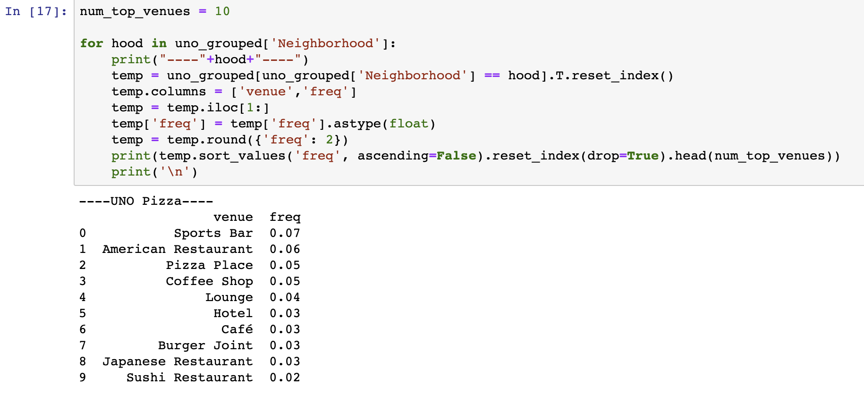
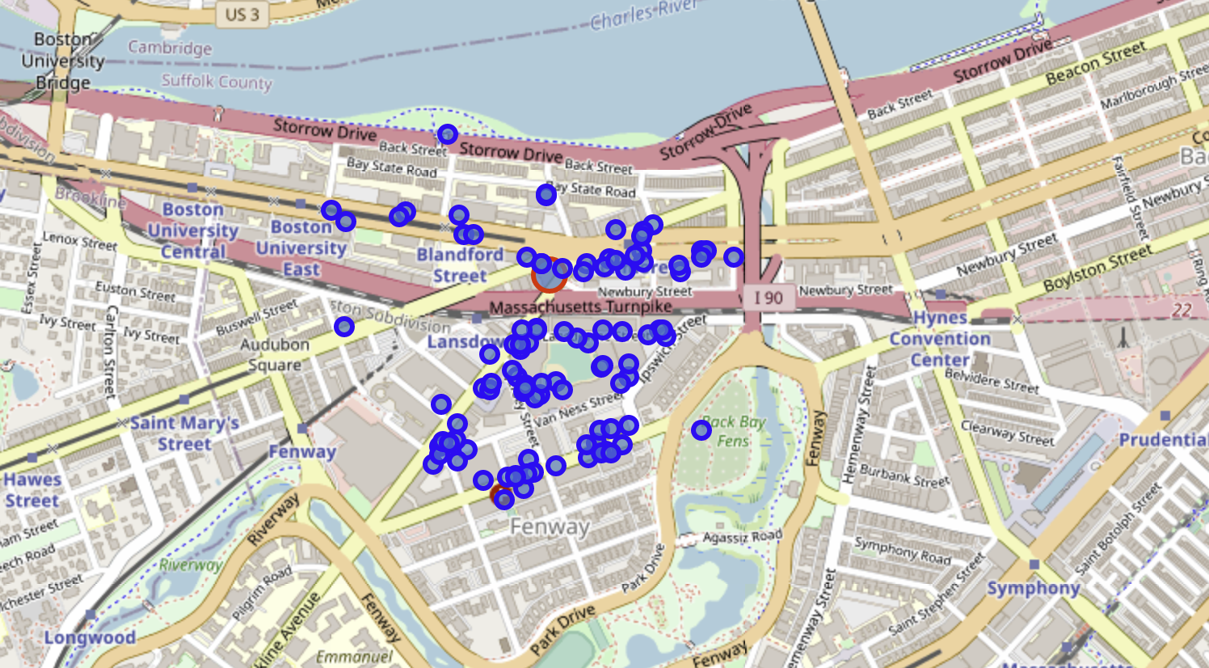
Analyzing existing UNO Store surrounding
Result :

Slide 6
Analyzing areas in Seattle for the new branch
Data : Foursquare location data, Neighborhood and district data from Wikipedia.
Task : Used the available location data to identify the different neighborhoods and their surroundings.
Method :
found the longitude and latitude of each neighborhoods in Seattle, WA.
Found venues around each neighborhood.
Used one-hot encoding to analyze each neighborhoods and the venues.
Found venues in each neighborhood and sorted to identify the top 10 venues.

Slide 7
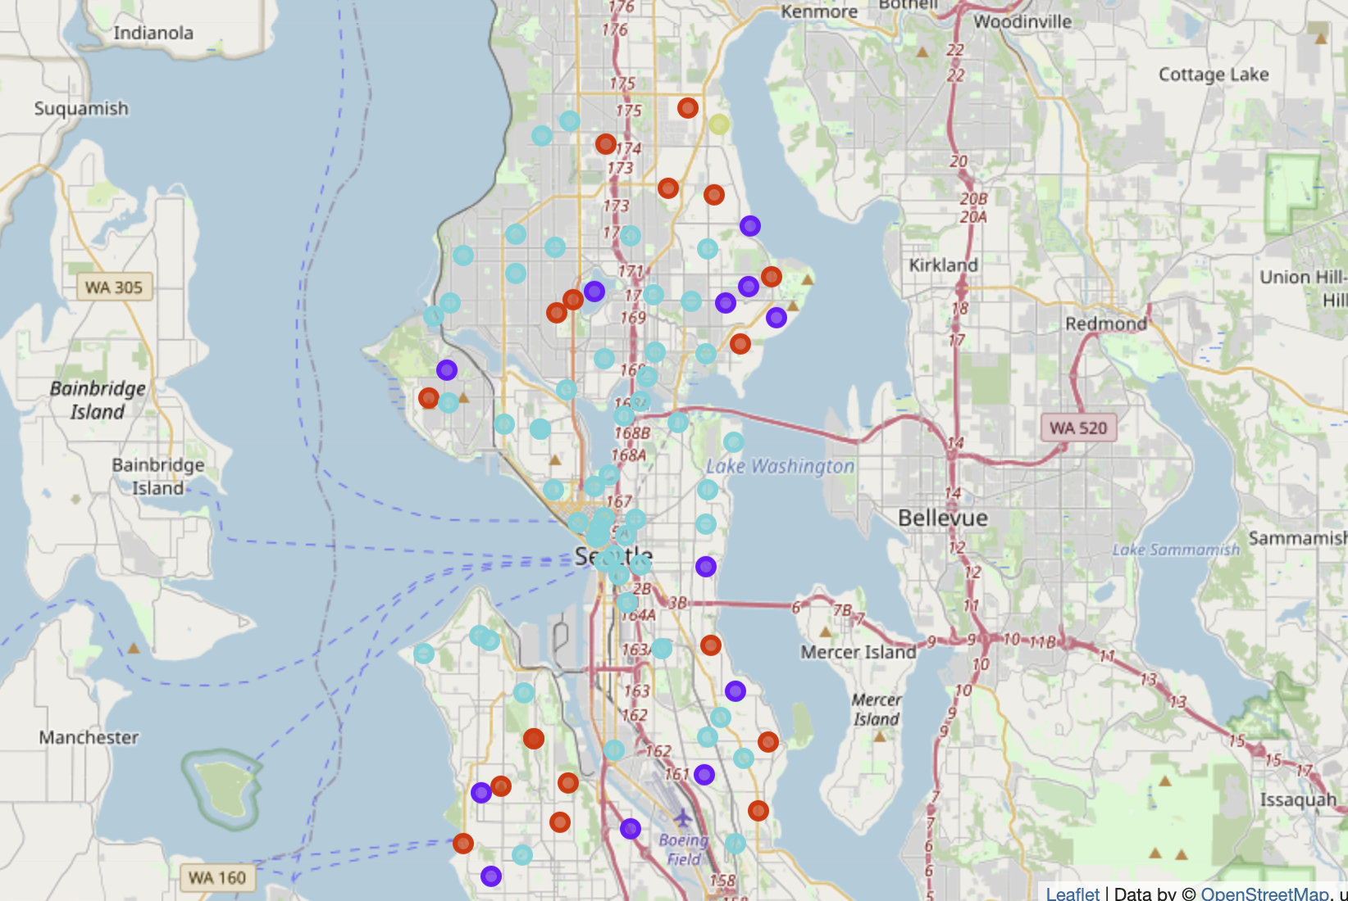
Clustering neighborhoods
Once identified the top 10 venues in each neighborhood, I used K-means clustering to group the neighborhood based on the location and the surrounded venues.
After a couple of attempts, it is identified 4 clusters are enough for this data set.

Slide 8
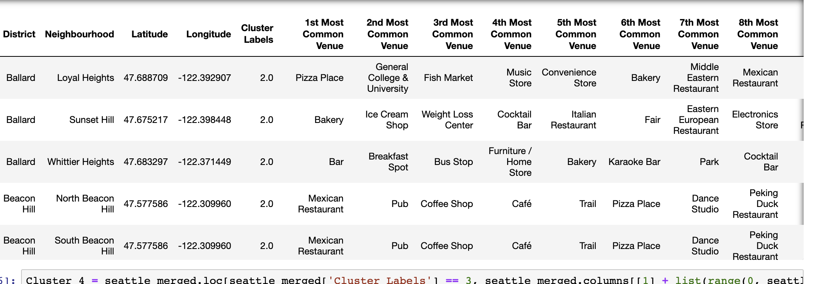
Evaluating the Clusters
Each cluster has been closely evaluated and it is identified third cluster contains most of the matching venues as it is with Boston neighborhood. Hence, the third cluster was selected for further analyzing.

Slide 9
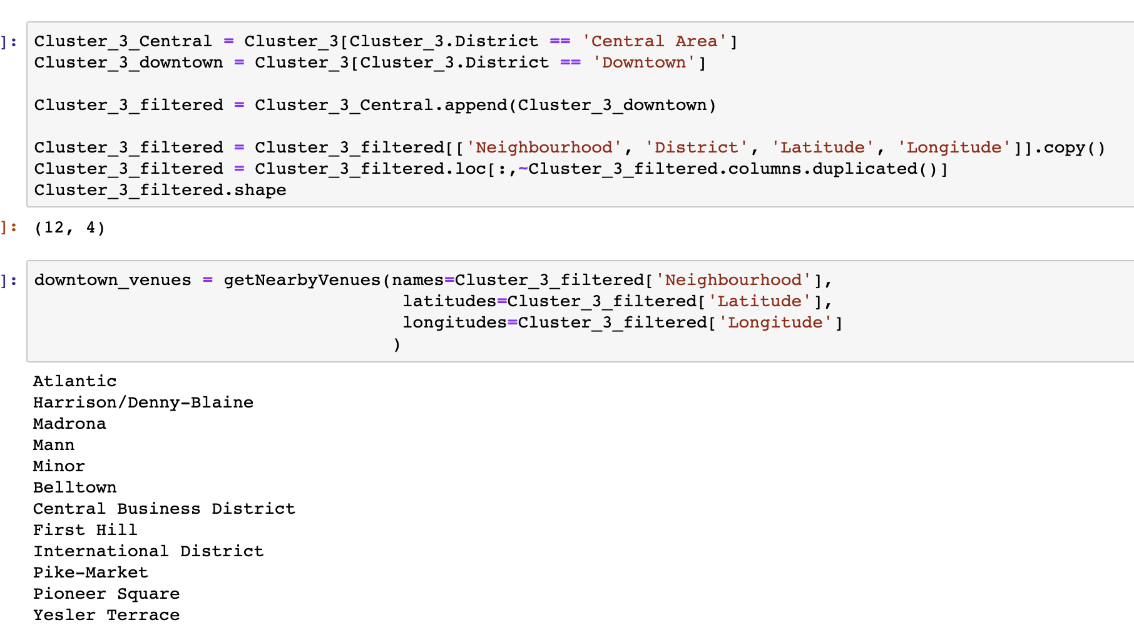
Data tuning
After selecting the most suitable cluster, it is important to filter the neighborhoods to include only the urban areas. That will help with more foot traffic and it will be easier for deliveries, transportation and advertising.

Slide 10
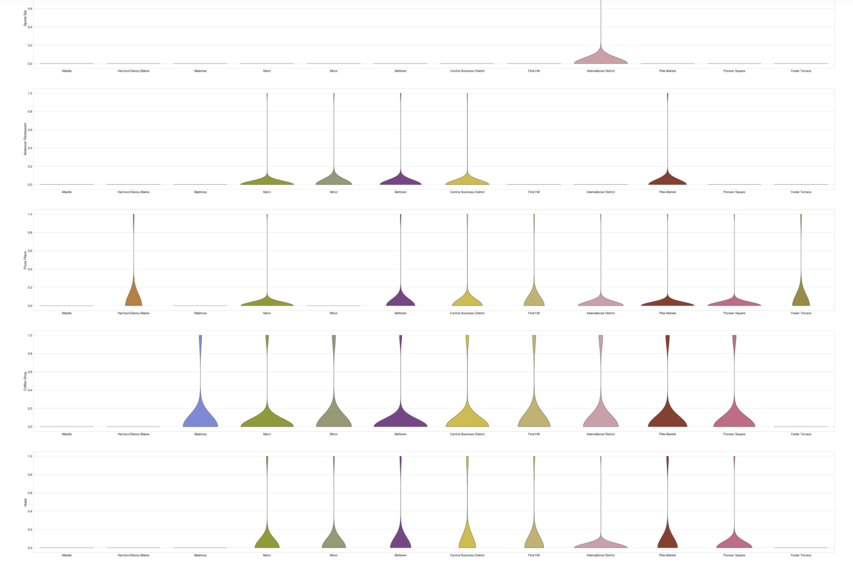
Finding the “neighborhood”
Once I have filtered the urban neighborhoods, the next step is finding the most suitable neighborhood. In order to do that, I used categorial plot to visualize top 5 venues in each neighborhood.

Slide 11
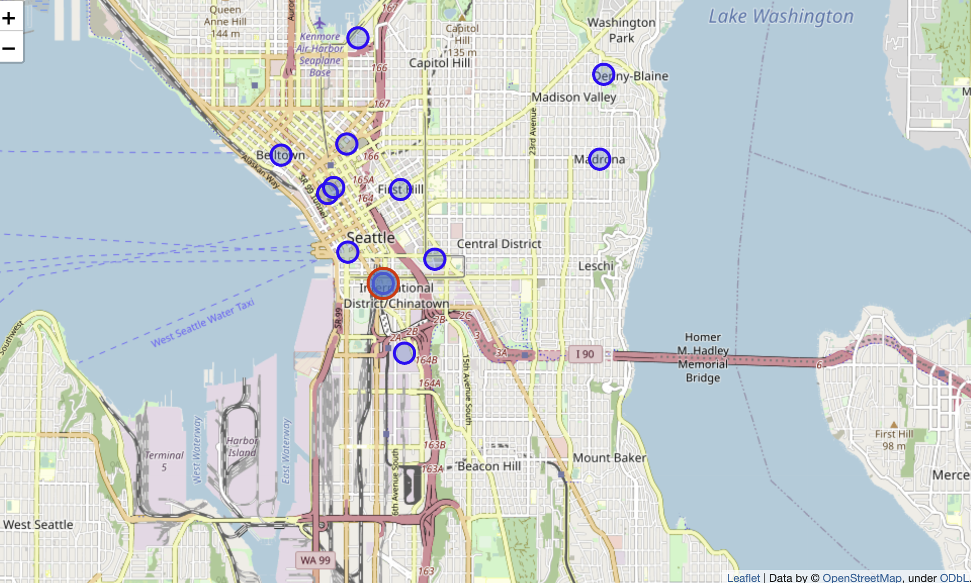
conclusion
After looking at the categorical plot, most of the neighborhoods have considerable amount of venues which are matching to Boston neighborhood. However, we will select the "international District" among the other neighborhoods. It contains Sports bars which is the top venue in Boston, and it has four out of five of other venues as well.

